Slide 1
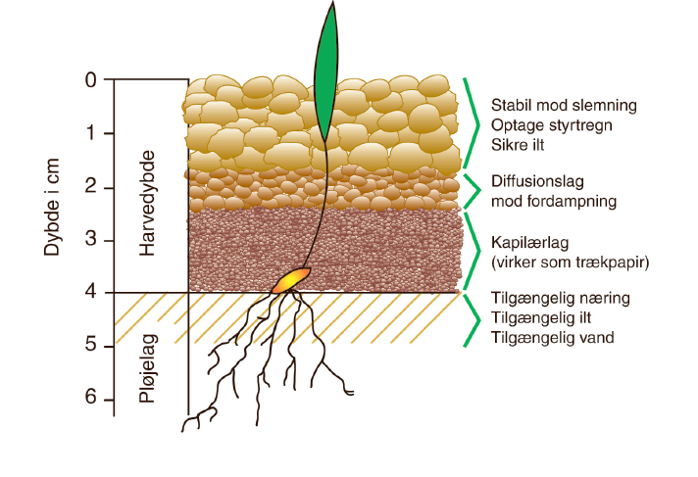
Figur 4.1

Slide 2
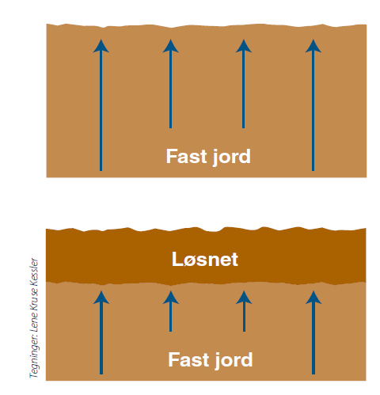
Figur 4.2

Slide 3
Figur 4.3

Slide 4
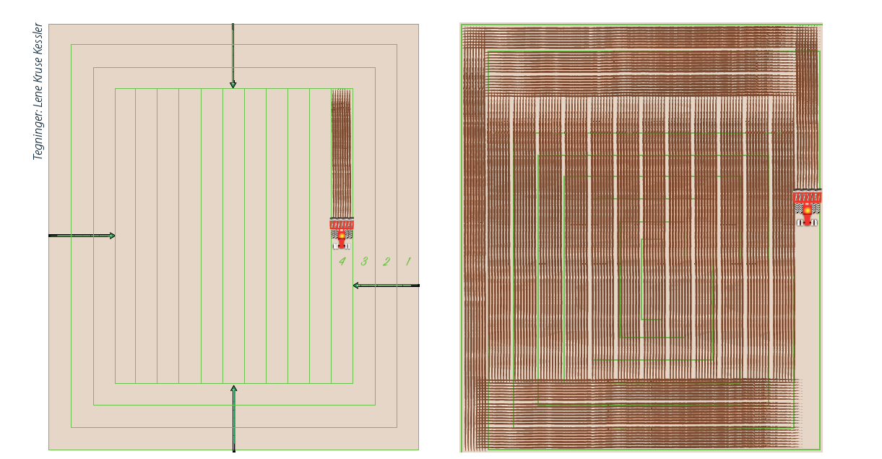
Figur 4.4 & 4.5

Slide 5
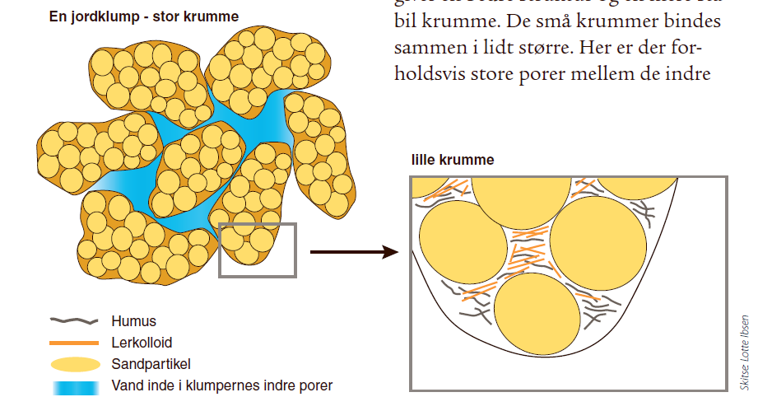
Figur 4.6

Slide 6
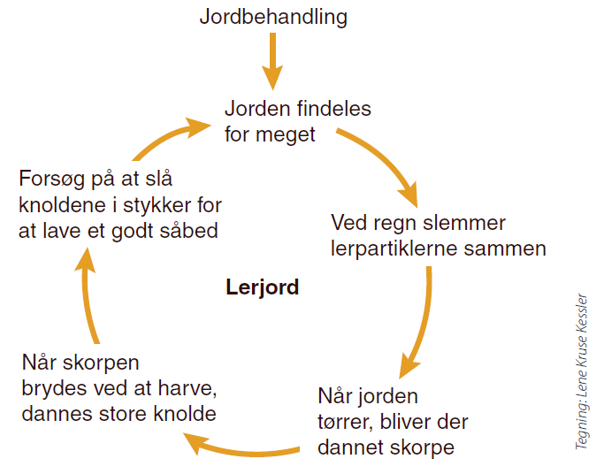
Figur 4.8

Slide 7
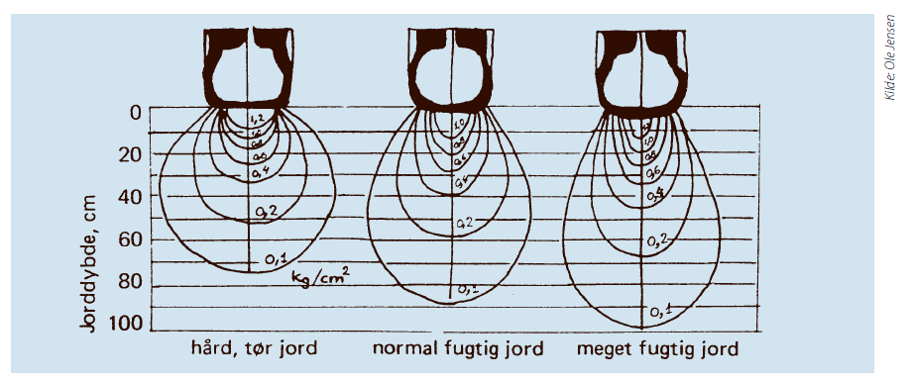
Figur 4.13

Slide 8
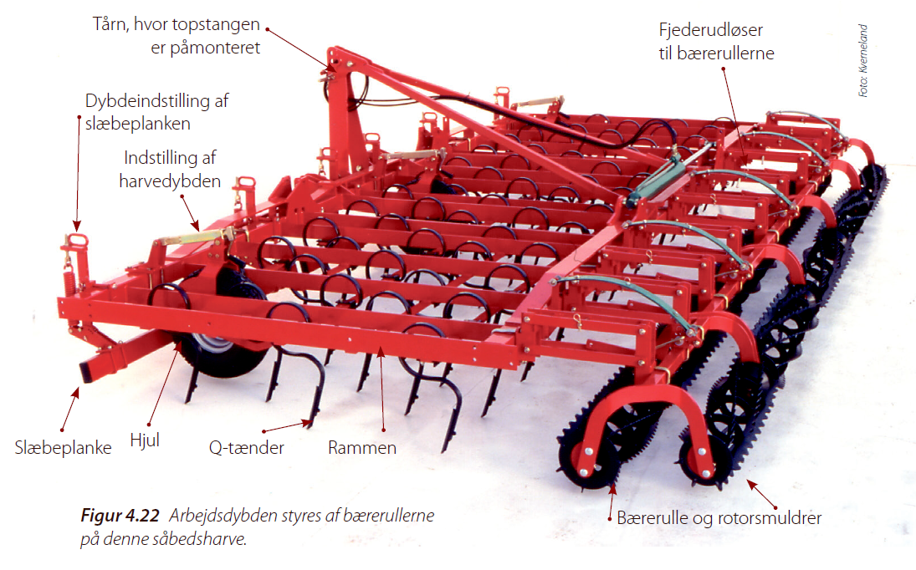
Figur 4.22

Slide 9
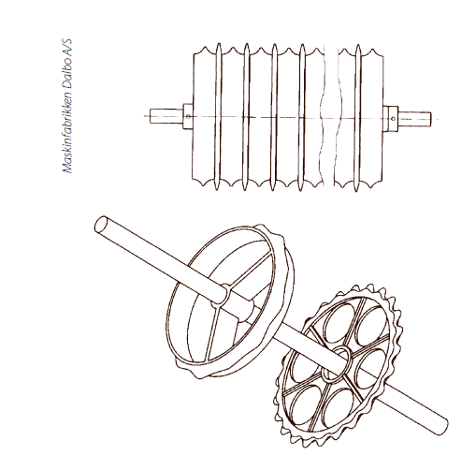
Figur 4.36

Slide 10
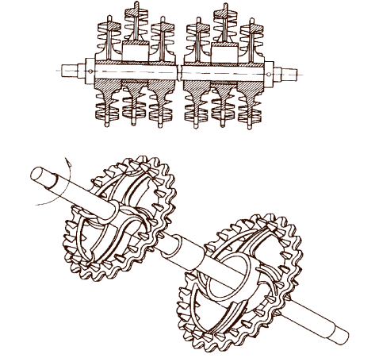
Figur 4.37

Slide 11
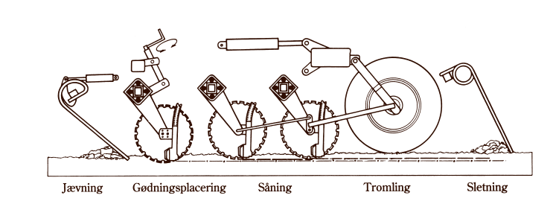
Figur 4.43

Slide 12
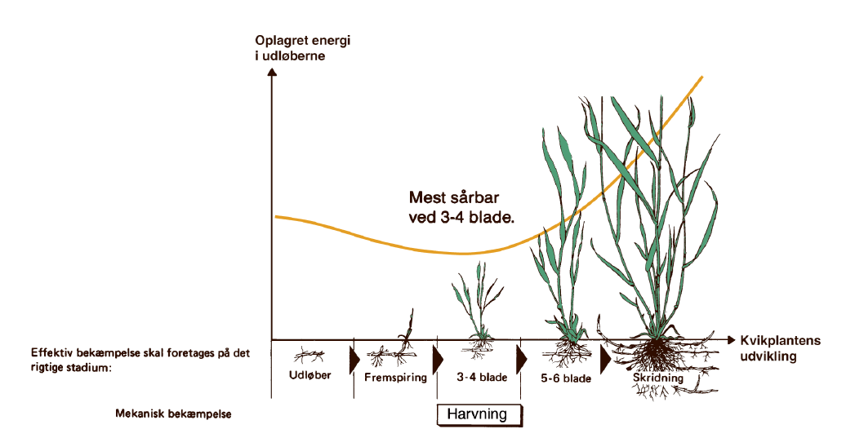
Figur 4.47

