Slide 1
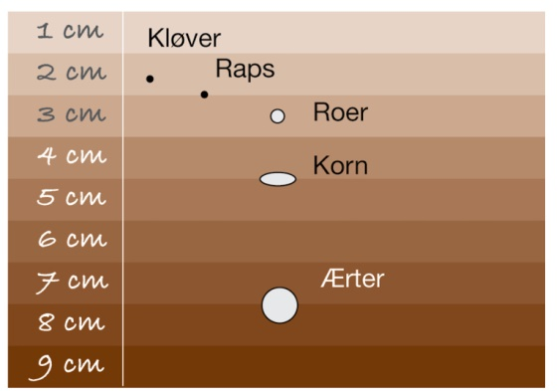
Figur 5.1

Slide 2
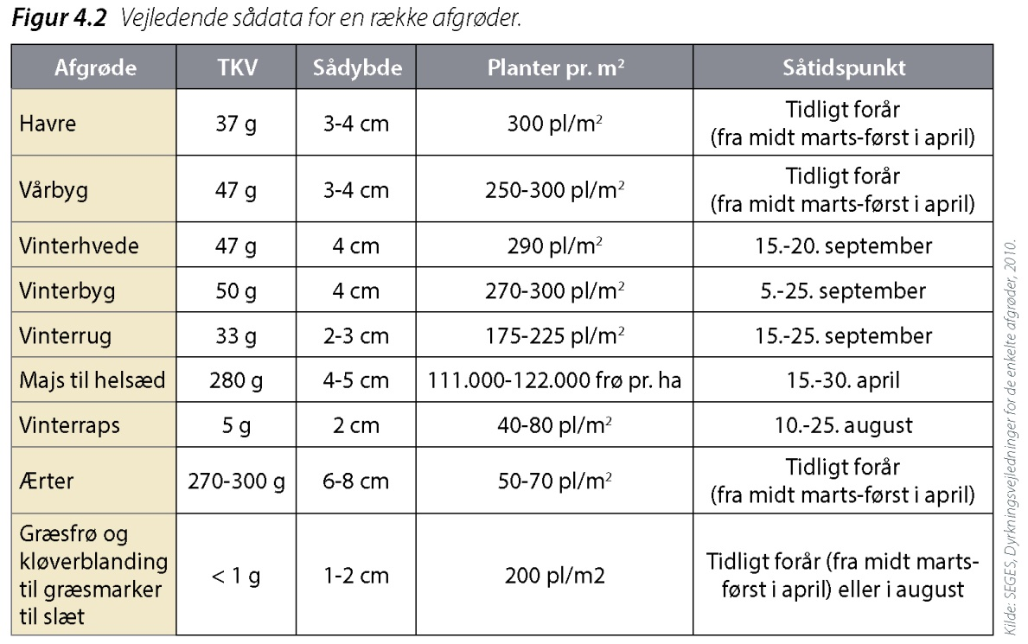
Figur 5.2

Slide 3
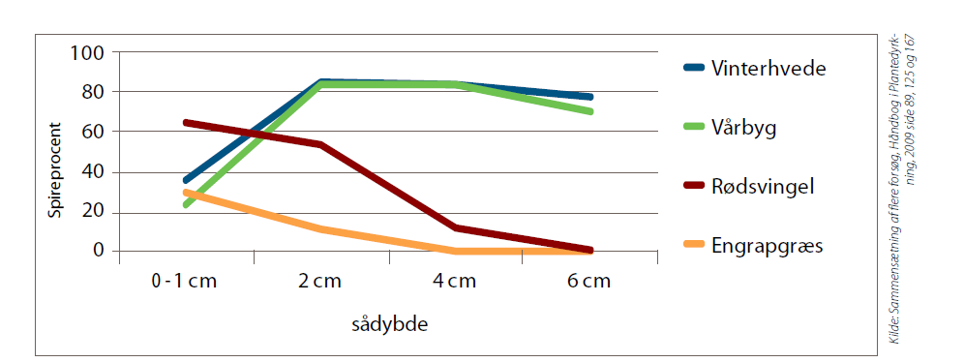
Figur 5.5

Slide 4
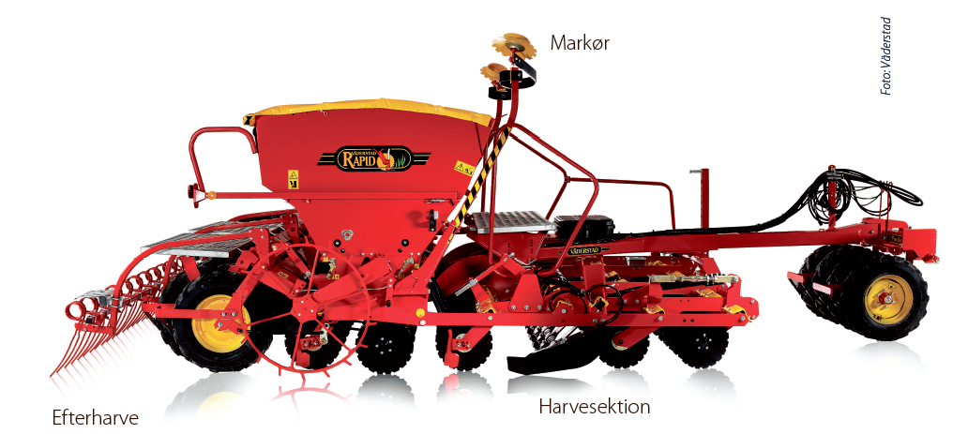
Figur 5.6

Slide 5
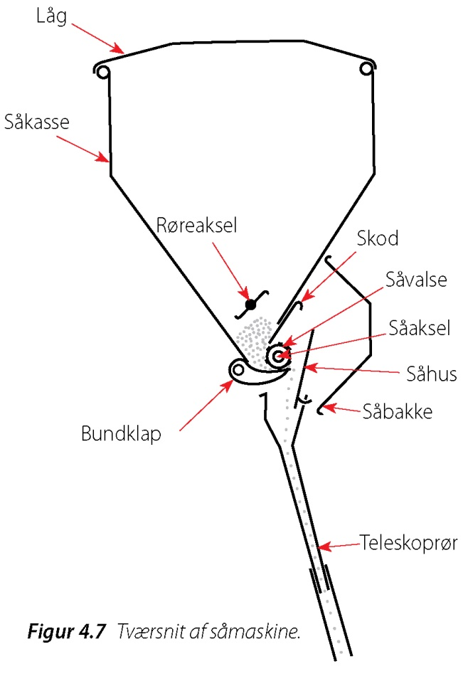
Figur 5.7

Slide 6
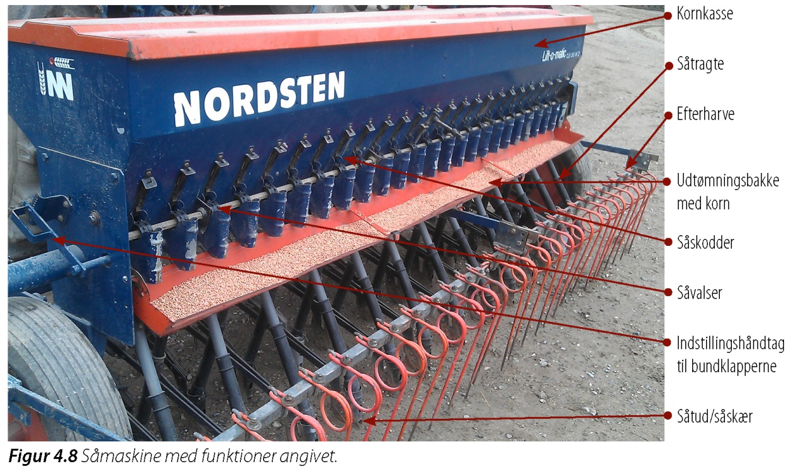
Figur 5.8

Slide 7
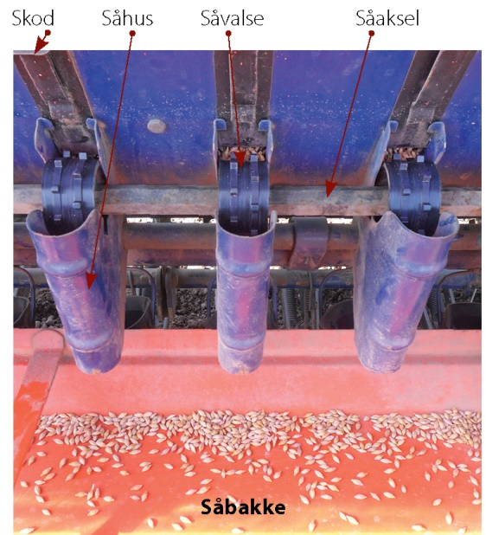
Figur 5.9

Slide 8
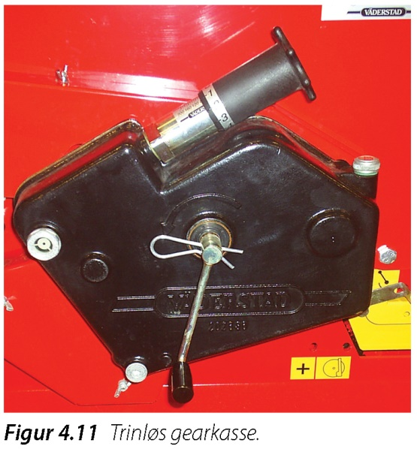
Figur 5.11

Slide 9
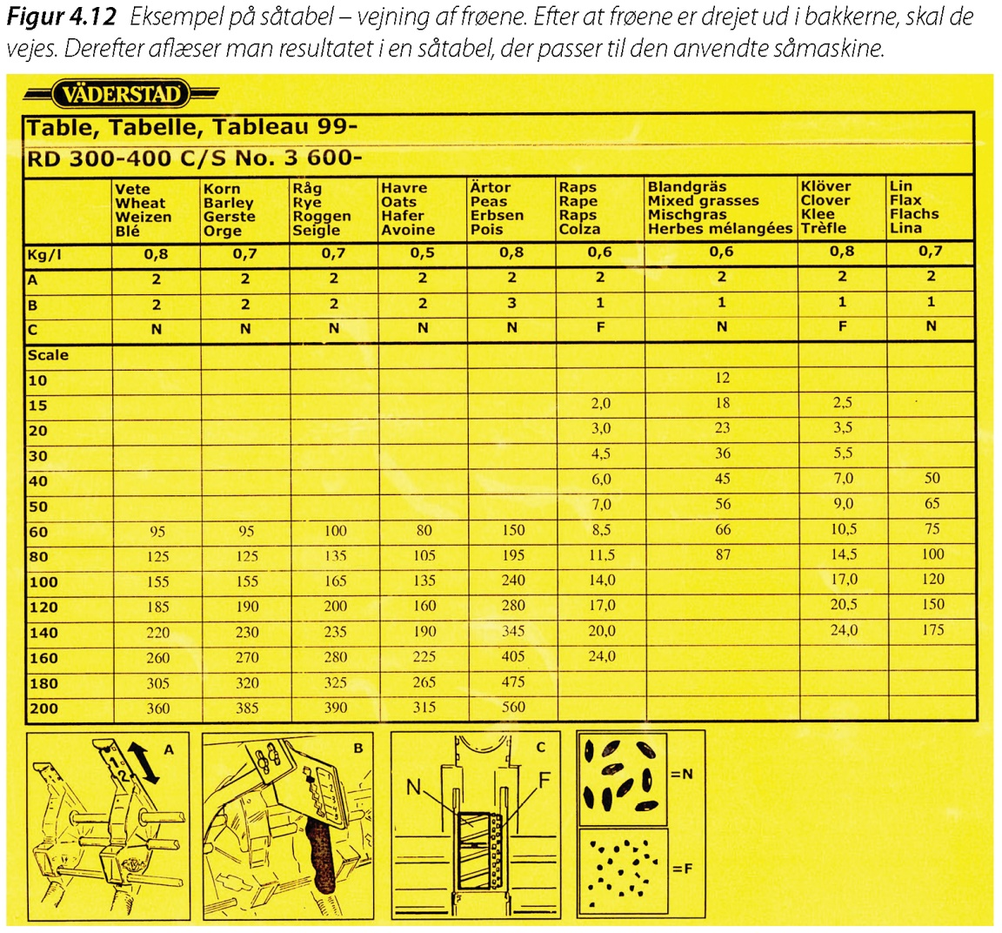
Figur 5.12

Slide 10
Figur 5.22

Slide 11
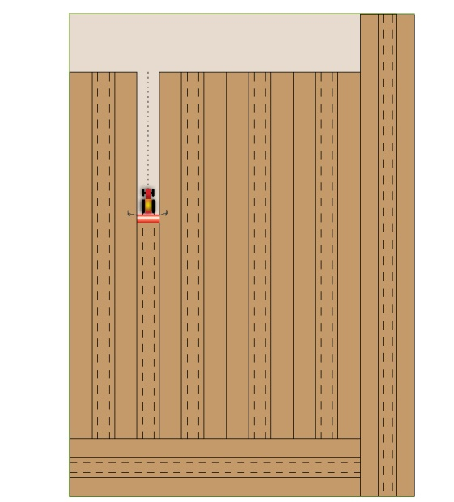
Figur 5.23

Slide 12
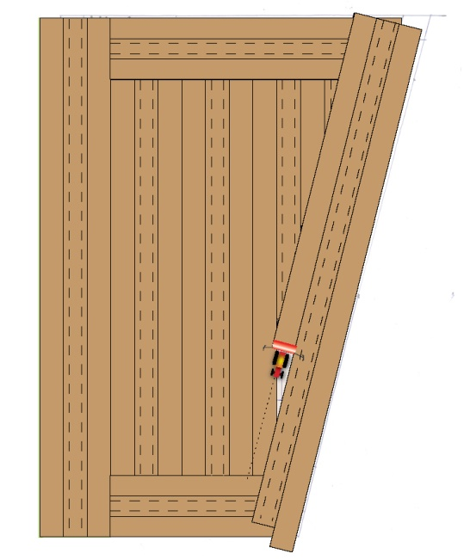
Figur 5.24

Slide 13
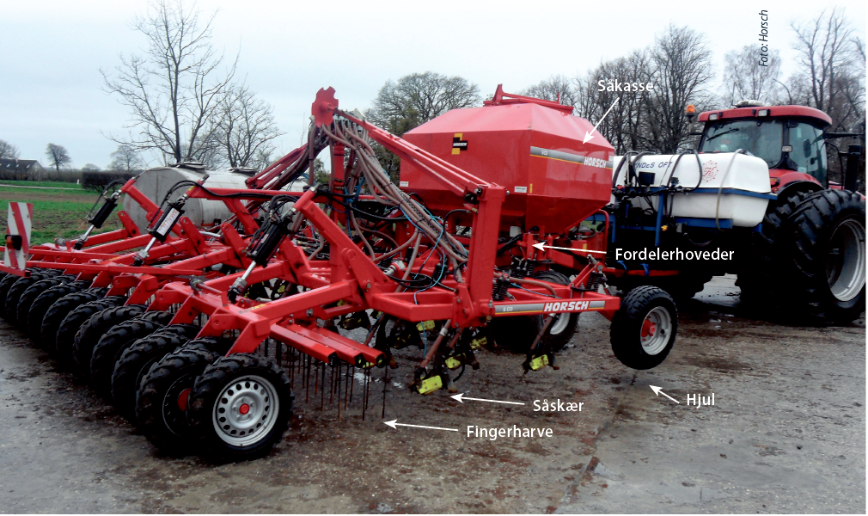
Figur 5.26

Slide 14
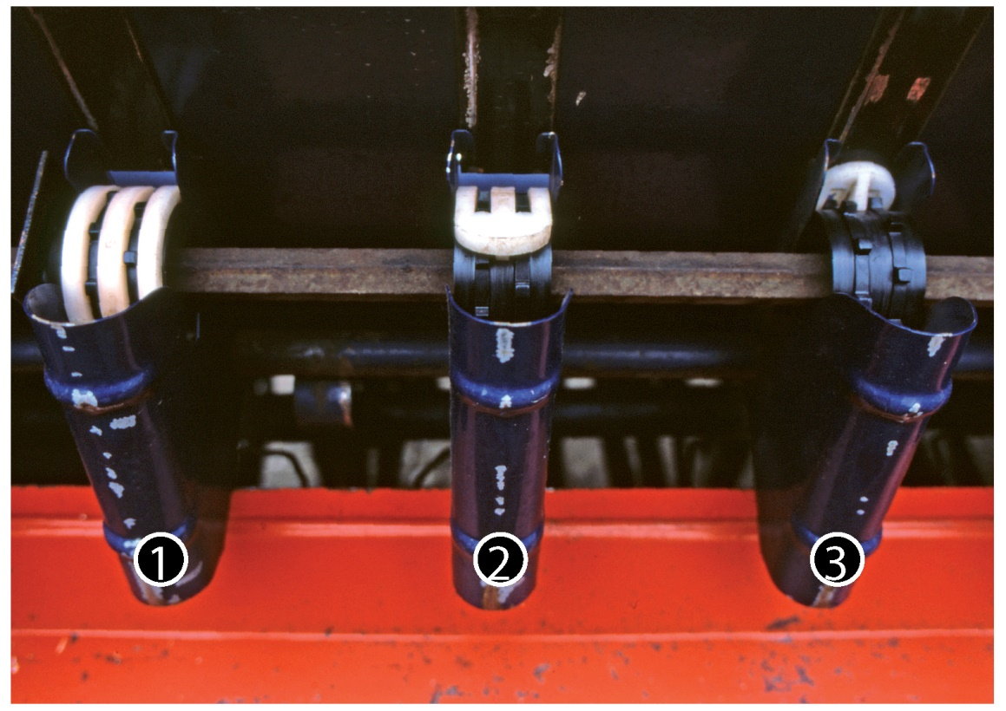
Figur 5.31

Slide 15
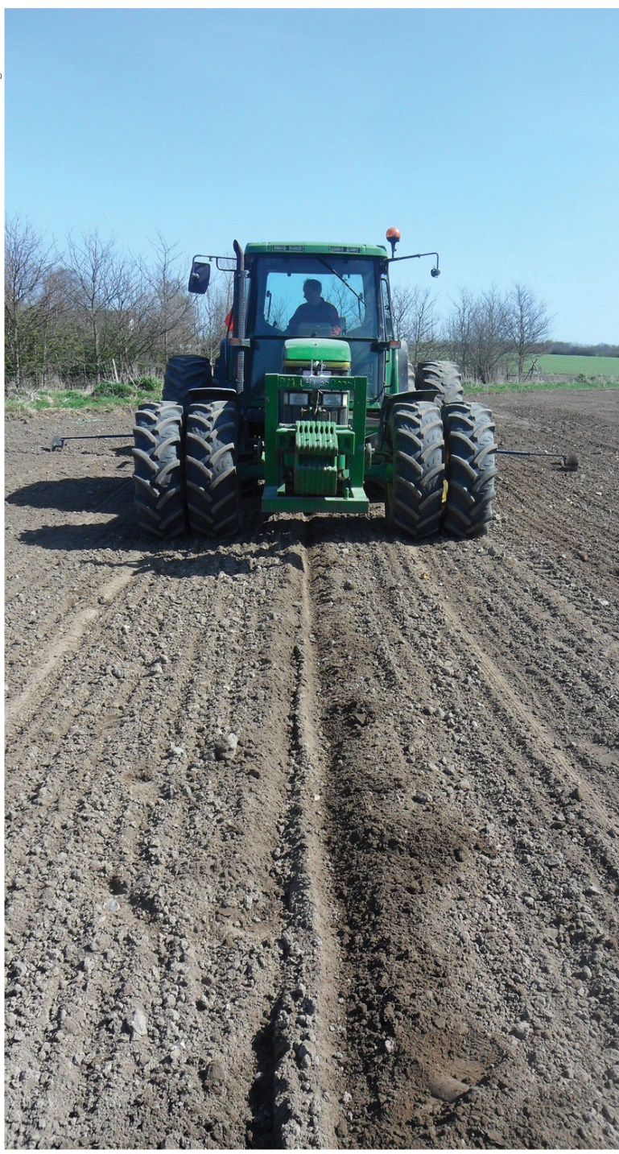
Figur 5.32

